Slide 1
TRAILS: topological reconstruction of the ancestry using incomplete lineage sorting
Iker Rivas-González

Slide 2
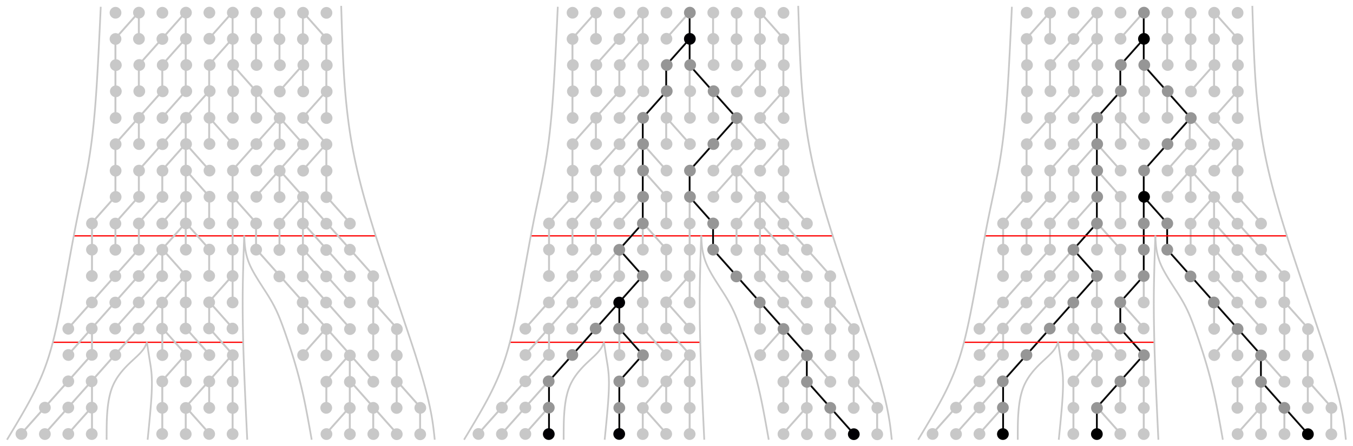
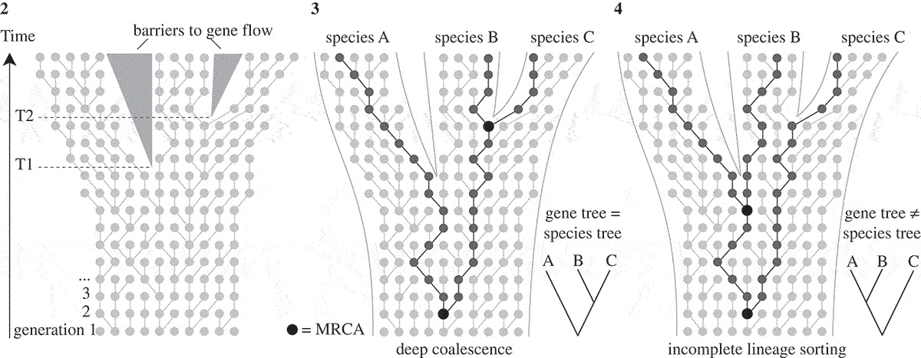
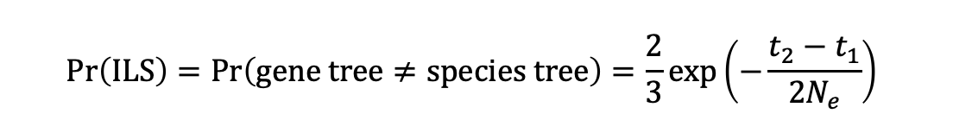
Incomplete lineage sorting (ILS)
Human Chimp Gorilla
Human Chimp Gorilla
Human Chimp Gorilla
$$\operatorname{Pr}\left(ILS\right)=\operatorname{Pr}\left(gene tree≠species tree\right)=\frac{2}{3}exp⁡\left(−\frac{t_{2}−t_{1}}{2N_{e}}\right)$$
Notes:
- Three species, two speciation events.
- If 1st coal between T1 and T2 -> gene tree = species tree
- If 1st coal escapes T2 -> maybe gene tree != species tree
- This is called ILS.
- Usually regarded as an obstacle for phylogenetic reconstruction.
- But valuable -> information-rich about speciation times and ancestral population sizes.

Slide 3
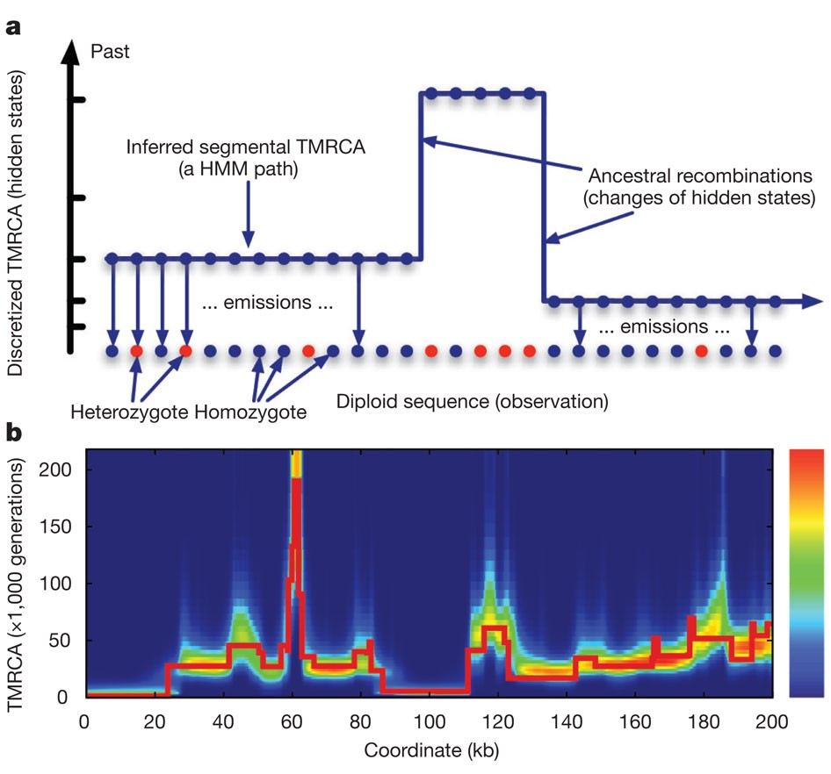
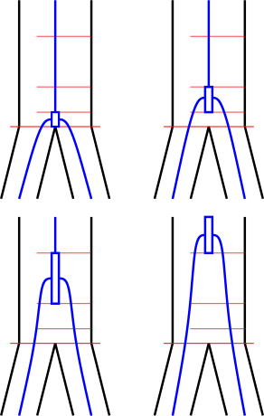
HMMs
SMCs
Li and Durbin (2011)
Notes:
- Sequentially Markovian coalescents
- Hidden states are discretized time intervals.
- Useful to model changes in Ne through time.
- Drawback: only one coalescent.
- CoalHMM:
-hidden states are phylogenetic trees
- V0: canonical topology
- V1, V2, V3: the others deep coalescence
- V2, V3: alternative topologies (ILS).
- Useful to infer spec times & ancestral Ne.
- Drawback: biased parameters.

Slide 4
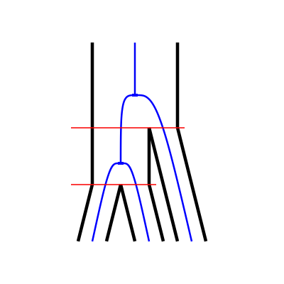
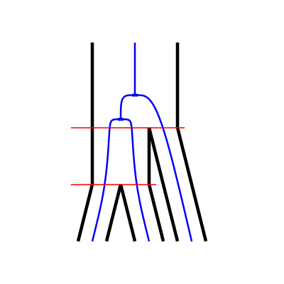
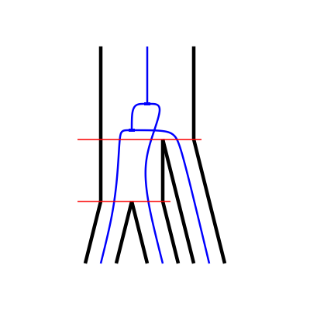
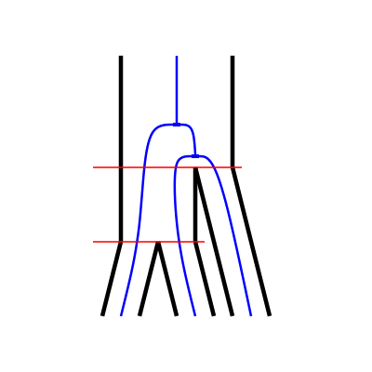
HMMs
V0
V1
CoalHMM
SMCs
V2
V3
Notes:
- Sequentially Markovian coalescents
- Hidden states are discretized time intervals.
- Useful to model changes in Ne through time.
- Drawback: only one coalescent.
- CoalHMM:
-hidden states are phylogenetic trees
- V0: canonical topology
- V1, V2, V3: the others deep coalescence
- V2, V3: alternative topologies (ILS).
- Useful to infer spec times & ancestral Ne.
- Drawback: biased parameters.

Slide 5
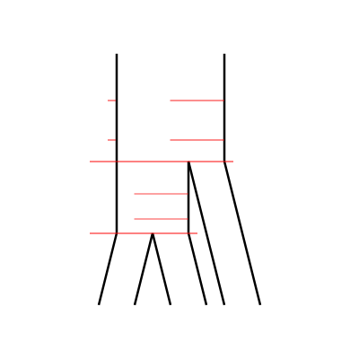
TRAILS
Topological Reconstruction of the Ancestry using Incomplete Lineage Sorting
Extract the ILS information CoalHMM-style
Parameterize with discretized time intervals SMC-style
Notes:
- Combine the two approaches.

Slide 6
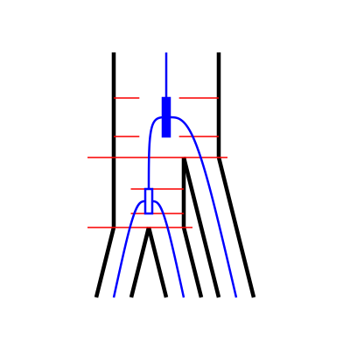
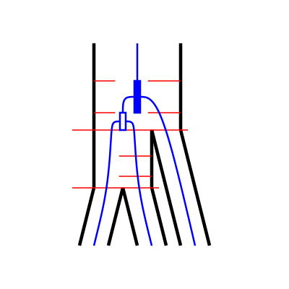
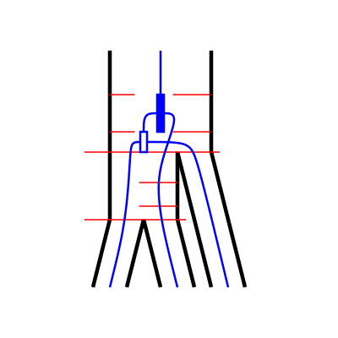
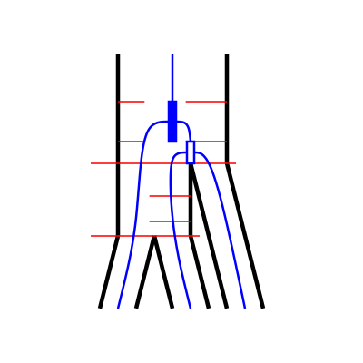
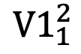
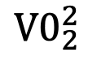
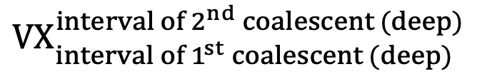
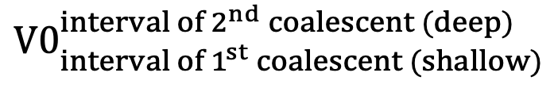
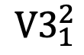
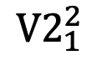
The hidden states
$${V0}_{2}^{2}$$
$${V1}_{1}^{2}$$
$${V2}_{1}^{2}$$
$${V3}_{1}^{2}$$
3
3
3
3
Deep
2
Deep
2
Deep
2
Deep
2
1
1
1
1
3
3
3
3
Shallow
Shallow
Shallow
Shallow
2
2
2
2
1
1
1
1
$${V0}_{{interval of 1}^{st} coalescent (shallow)}^{{interval of 2}^{nd} coalescent (deep)}$$
$${VX}_{{interval of 1}^{st} coalescent (deep)}^{{interval of 2}^{nd} coalescent (deep)}$$
Notes:
- New hidden states: phylogenetic trees with two discretized coalescent events.
- V0 -> set of V0 states, each with a combination of coal times.

Slide 7
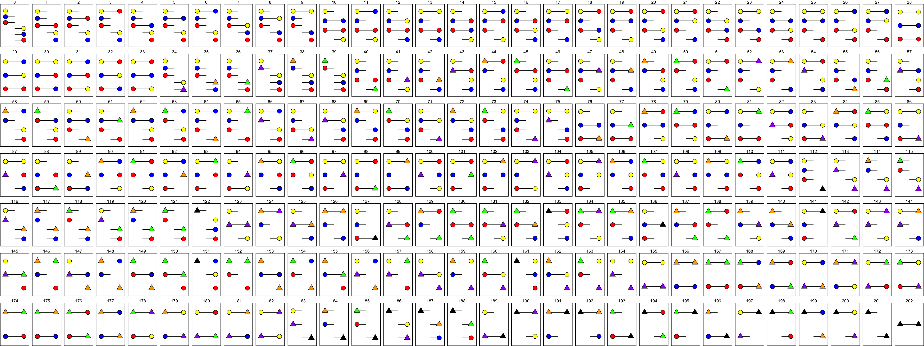
The CTMCs
Three-sequence CTMC
Two-sequence CTMC
One-sequence CTMC
One-sequence CTMC
One-sequence CTMC
Notes:
- ILSMC is built by interconnected CTMCs (continuous-time Markov chains).
- These are needed to get the transition probability matrix of ILSMC.

Slide 8
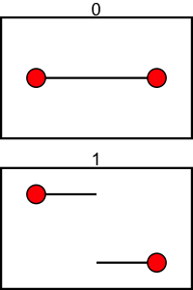
The CTMCs
1C
1R

Slide 9
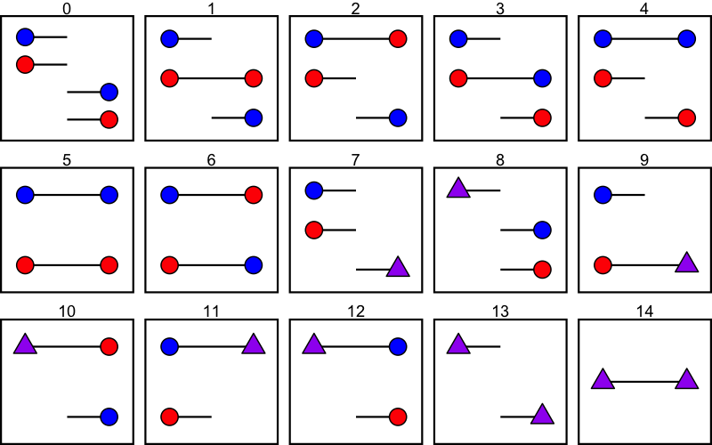
The CTMCs

Slide 10
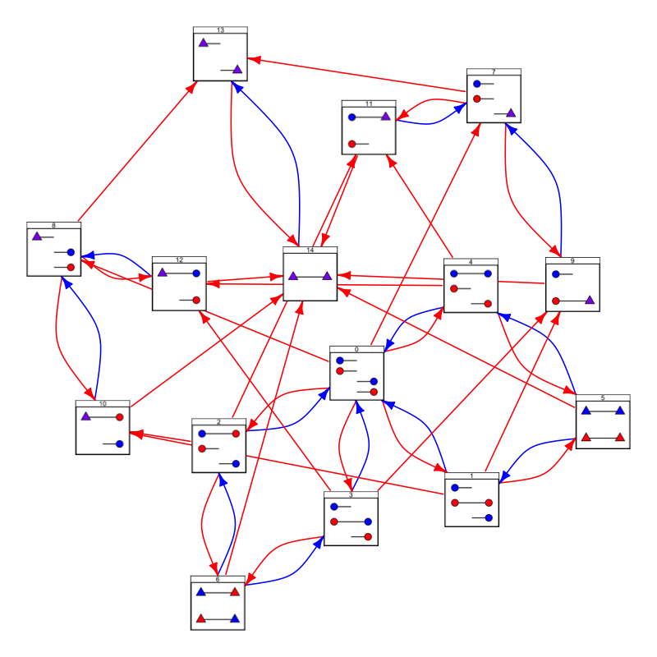
The CTMCs

Slide 11
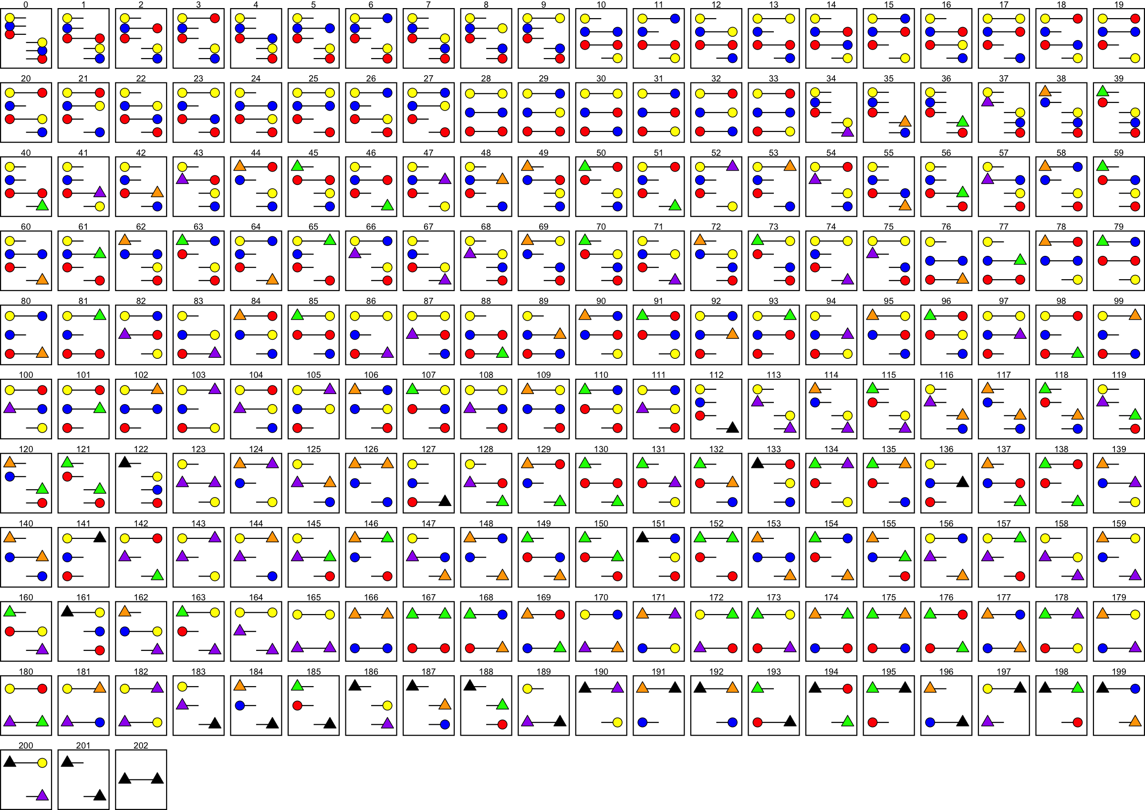
The CTMCs

Slide 12
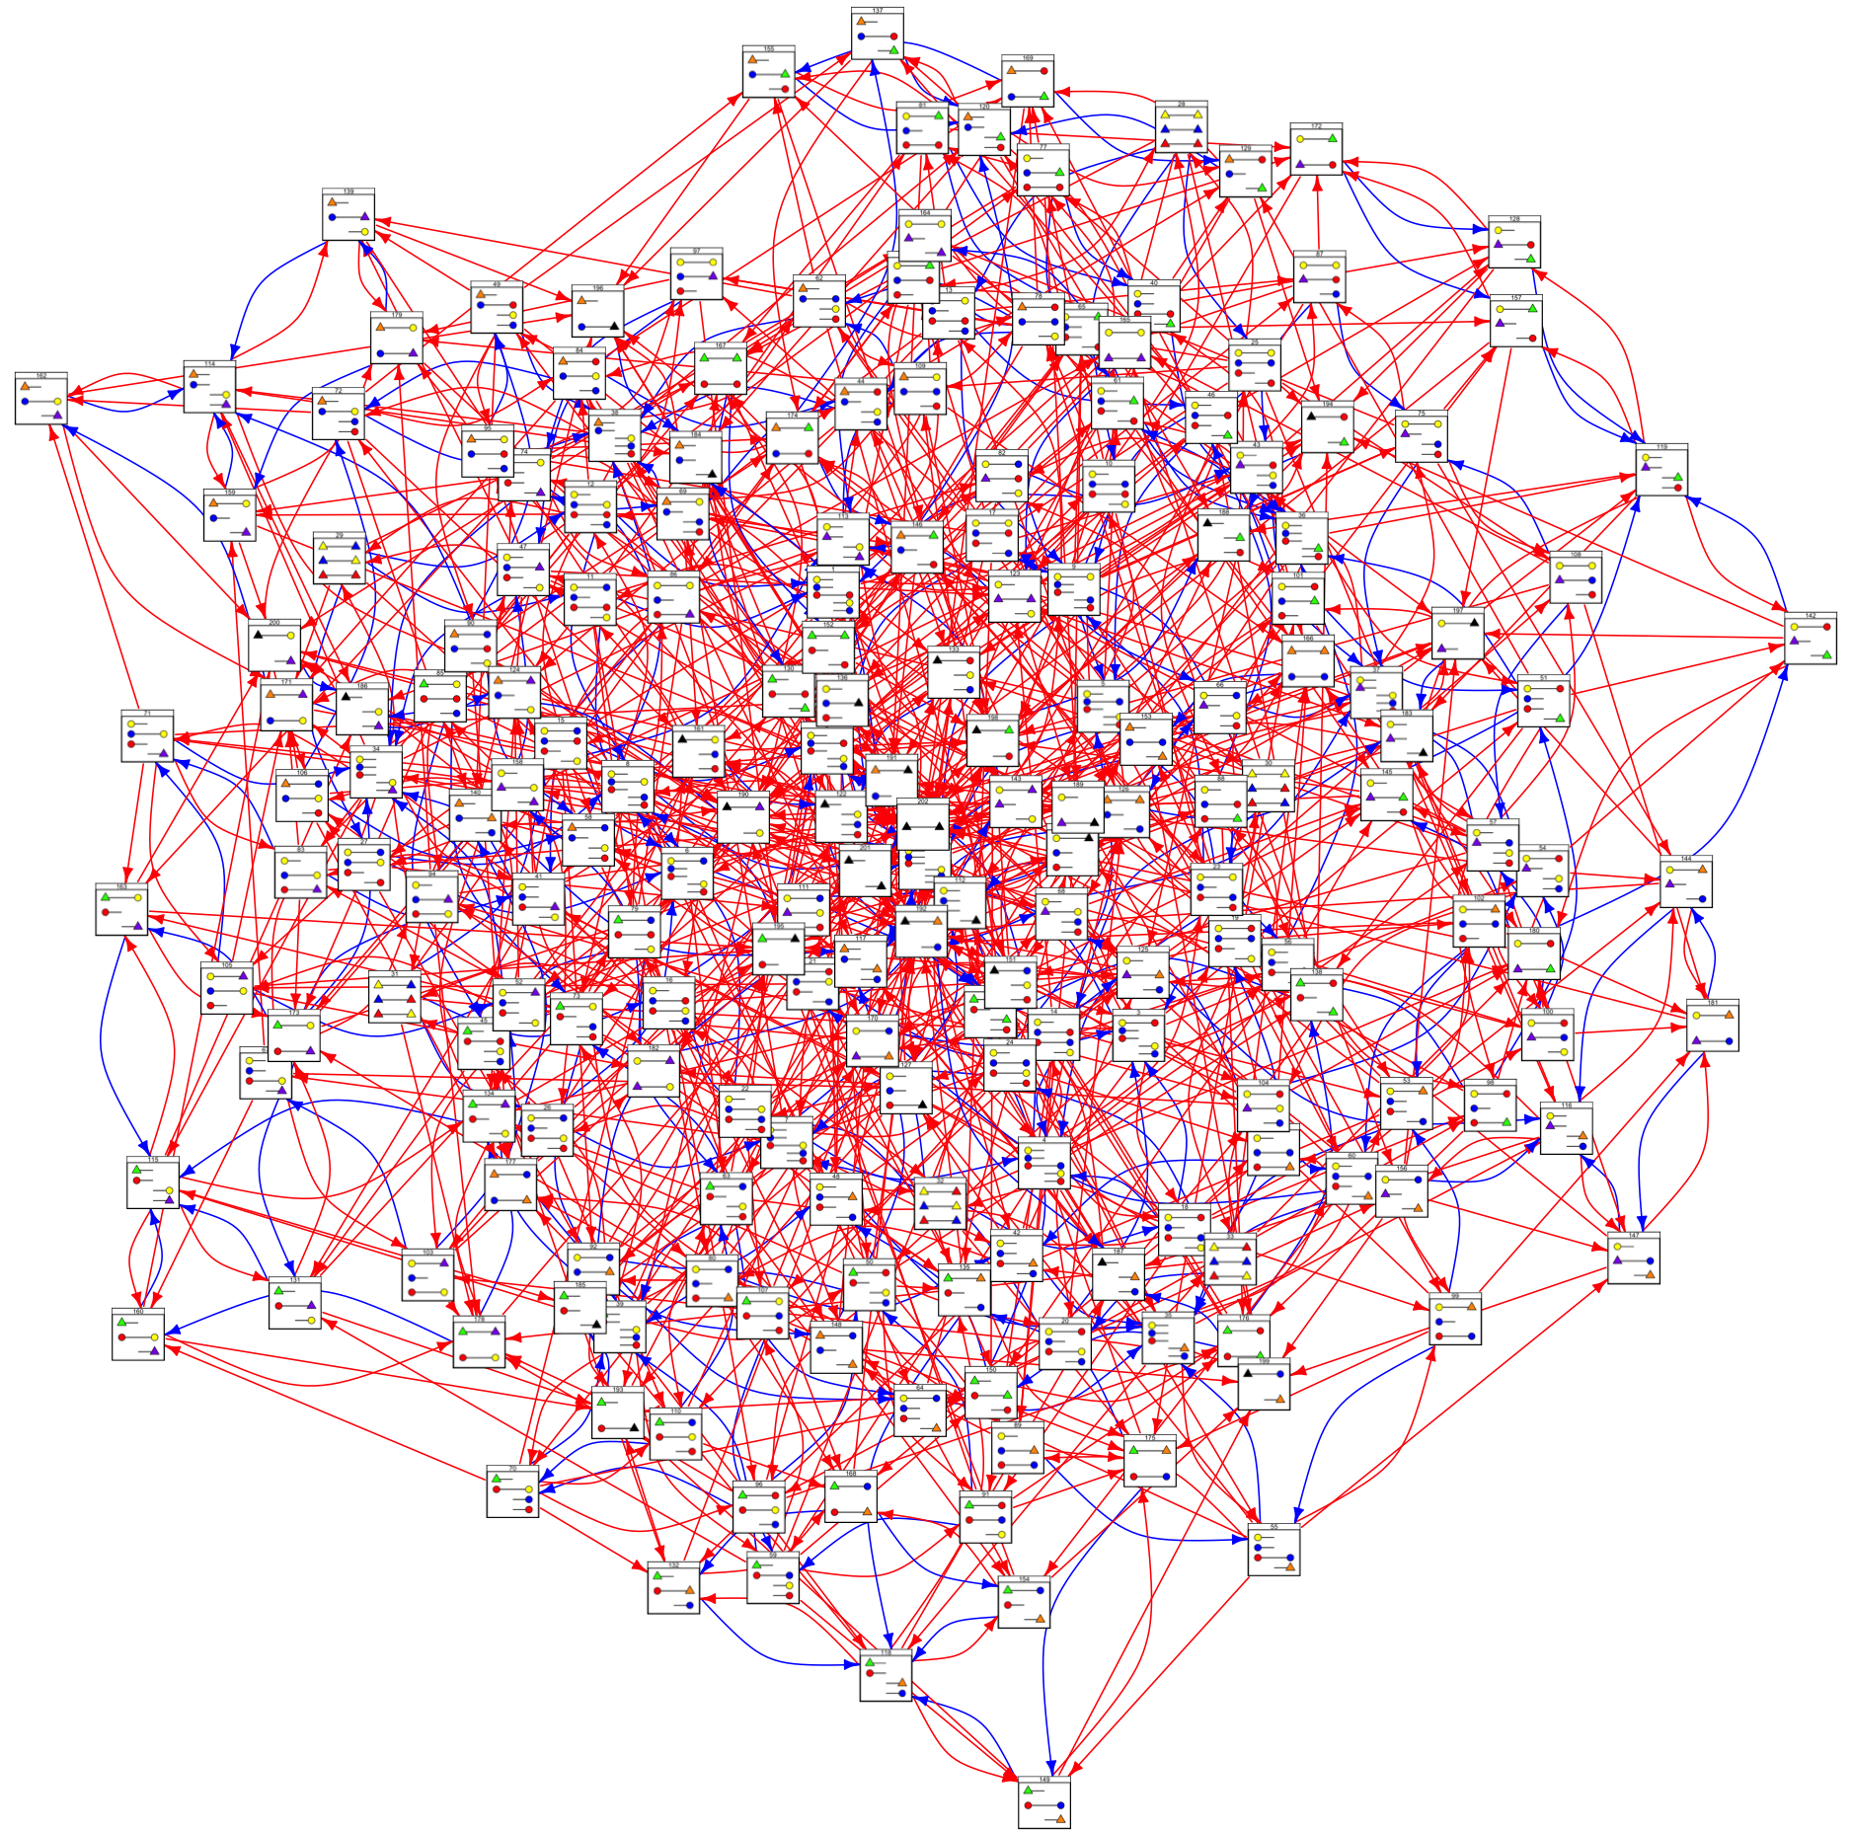
The CTMCs

Slide 13
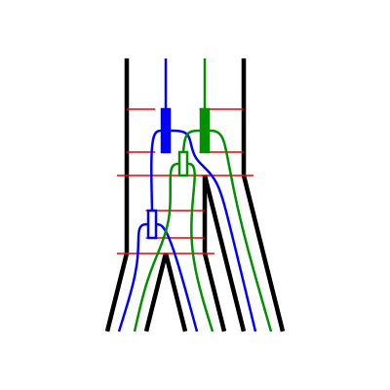
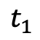
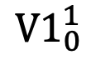
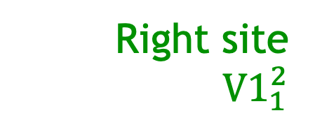
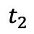
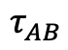
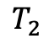
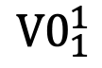
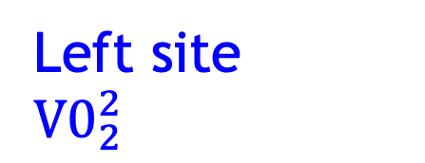
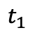
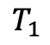
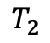
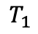
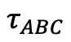
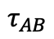
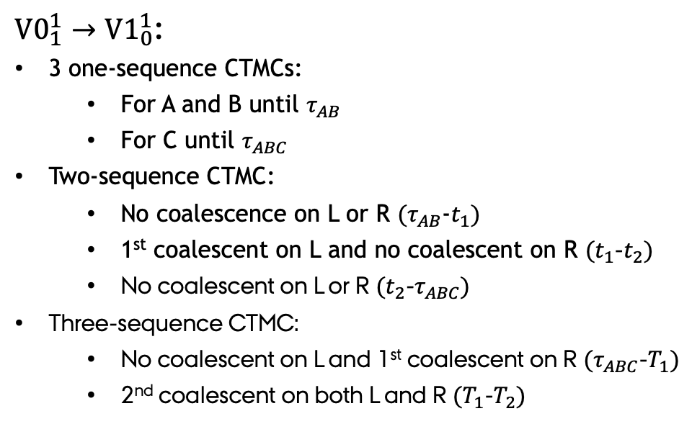
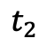
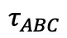
The transition probability matrix
Right site
${V1}_{1}^{2}$
Left site
Right site
Left site
$${V0}_{2}^{2}$$
${V0}_{1}^{1}→{V1}_{0}^{1}$:
3 one-sequence CTMCs:
For A and B until $τ_{AB}$
For C until $τ_{ABC}$
Two-sequence CTMC:
No coalescence on L or R $(τ_{AB}$-$t_{1})$
1st coalescent on L and no coalescent on R $(t_{1}$-$t_{2})$
No coalescent on L or R $(t_{2}$-$τ_{ABC})$
Three-sequence CTMC:
No coalescent on L and 1st coalescent on R $(τ_{ABC}$-$T_{1})$
2nd coalescent on both L and R $(T_{1}$-$T_{2})$
$${V0}_{1}^{1}$$
$${V1}_{0}^{1}$$
$$T_{2}$$
$$T_{2}$$
$$T_{1}$$
$$T_{1}$$
$$τ_{ABC}$$
$$τ_{ABC}$$
$$t_{2}$$
$$t_{2}$$
$$t_{1}$$
$$t_{1}$$
$$τ_{AB}$$
$$τ_{AB}$$

Slide 14
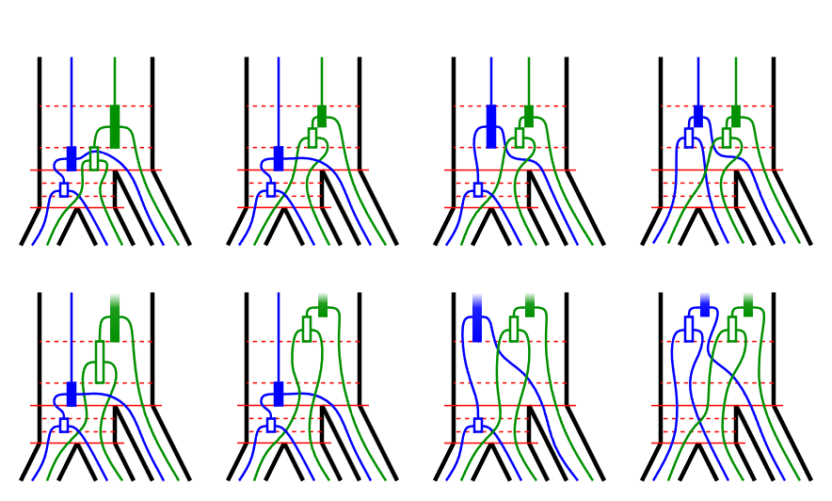
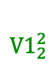
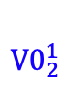
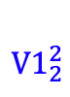
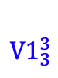
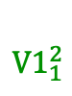










The transition probability matrix
$${V0}_{2}^{1}$$
$${V1}_{1}^{2}$$
$${V0}_{2}^{1}$$
$${V1}_{2}^{2}$$
$${V0}_{2}^{2}$$
$${V1}_{2}^{2}$$
$${V1}_{2}^{2}$$
$${V1}_{2}^{2}$$
Left site
Right site
${V0}_{1}^{1}→{V1}_{0}^{1}$:
3 one-sequence CTMCs:
For A and B until $τ_{AB}$
For C until $τ_{ABC}$
Two-sequence CTMC:
No coalescence on L or R $(τ_{AB}$-$t_{1})$
1st coalescent on L and no coalescent on R $(t_{1}$-$t_{2})$
No coalescent on L or R $(t_{2}$-$τ_{ABC})$
Three-sequence CTMC:
No coalescent on L and 1st coalescent on R $(τ_{ABC}$-$T_{1})$
2nd coalescent on both L and R $(T_{1}$-$T_{2})$
$${V0}_{1}^{1}$$
$${V1}_{0}^{1}$$
$$T_{2}$$
$${V0}_{2}^{1}$$
$${V1}_{2}^{3}$$
$${V0}_{2}^{1}$$
$${V1}_{3}^{3}$$
$${V0}_{2}^{3}$$
$${V1}_{3}^{3}$$
$${V1}_{3}^{3}$$
$${V1}_{3}^{3}$$
$$T_{1}$$
$$τ_{ABC}$$
$$t_{2}$$
$$t_{1}$$
$$τ_{AB}$$

Slide 15














The transition probability matrix
$$ρ_{ABC}$$
$$θ_{ABC}$$
$$n_{ABC}$$
$$ρ_{AB}$$
$$θ_{AB}$$
$$n_{ABC}$$
$$τ_{AB}$$
$$ρ_{C}$$
$$θ_{C}$$
$$τ_{c}$$
$$τ_{A}$$
$$ρ_{A}$$
$$ρ_{B}$$
$$τ_{B}$$
$$θ_{A}$$
$$θ_{B}$$

Slide 16

Simulating from the model

Slide 17

Simulating from the model
$${V0}_{1}^{1}$$

Slide 18

Simulating from the model
$${V3}_{1}^{2}$$

Slide 19
Emission probabilities
$${V3}_{1}^{2}$$
Analytical calculations using JC69
A A A A
A A A T
A A A C
A A A G
A A T A
A A T T
A A T C
A A T G
A A C A
A A C T
A A C C
A A C G
A A G A
A A G T
A A G C
A A G G
A T A A
A T A T
A T A C
A T A G
A T T A
A T T T
A T T C
A T T G
A T C A
A T C T
A T C C
A T C G
A T G A
A T G T
A T G C
A T G G
A C A A
A C A T
A C A C
A C A G
A C T A
A C T T
A C T C
A C T G
A C C A
A C C T
A C C C
A C C G
A C G A
A C G T
A C G C
A C G G
A G A A
A G A T
A G A C
A G A G
A G T A
A G T T
A G T C
A G T G
A G C A
A G C T
A G C C
A G C G
A G G A
A G G T
A G G C
A G G G
T A A A
T A A T
T A A C
T A A G
T A T A
T A T T
T A T C
T A T G
T A C A
T A C T
T A C C
T A C G
T A G A
T A G T
T A G C
T A G G
T T A A
T T A T
T T A C
T T A G
T T T A
T T T T
T T T C
T T T G
T T C A
T T C T
T T C C
T T C G
T T G A
T T G T
T T G C
T T G G
T C A A
T C A T
T C A C
T C A G
T C T A
T C T T
T C T C
T C T G
T C C A
T C C T
T C C C
T C C G
T C G A
T C G T
T C G C
T C G G
T G A A
T G A T
T G A C
T G A G
T G T A
T G T T
T G T C
T G T G
T G C A
T G C T
T G C C
T G C G
T G G A
T G G T
T G G C
T G G G
C A A A
C A A T
C A A C
C A A G
C A T A
C A T T
C A T C
C A T G
C A C A
C A C T
C A C C
C A C G
C A G A
C A G T
C A G C
C A G G
C T A A
C T A T
C T A C
C T A G
C T T A
C T T T
C T T C
C T T G
C T C A
C T C T
C T C C
C T C G
C T G A
C T G T
C T G C
C T G G
C C A A
C C A T
C C A C
C C A G
C C T A
C C T T
C C T C
C C T G
C C C A
C C C T
C C C C
C C C G
C C G A
C C G T
C C G C
C C G G
C G A A
C G A T
C G A C
C G A G
C G T A
C G T T
C G T C
C G T G
C G C A
C G C T
C G C C
C G C G
C G G A
C G G T
C G G C
C G G G
G A A A
G A A T
G A A C
G A A G
G A T A
G A T T
G A T C
G A T G
G A C A
G A C T
G A C C
G A C G
G A G A
G A G T
G A G C
G A G G
G T A A
G T A T
G T A C
G T A G
G T T A
G T T T
G T T C
G T T G
G T C A
G T C T
G T C C
G T C G
G T G A
G T G T
G T G C
G T G G
G C A A
G C A T
G C A C
G C A G
G C T A
G C T T
G C T C
G C T G
G C C A
G C C T
G C C C
G C C G
G C G A
G C G T
G C G C
G C G G
G G A A
G G A T
G G A C
G G A G
G G T A
G G T T
G G T C
G G T G
G G C A
G G C T
G G C C
G G C G
G G G A
G G G T
G G G C
G G G G

Slide 20
Discussion
Current state:
Transition probability matrix calculated

Slide 21
Discussion
Next steps:
Finish the emission probabilities

Slide 22
Discussion
Current state:
Transition probability matrix calculated
Future work:
Optimize transition probability matrix
Emission probabilities.
Chose and code optimization procedure
Analyze simulated data
Future perspective:
ILSMC is flexible:
Different parameterization per interval
ILSMC is extensible:
ILS and introgression

